Slide 1
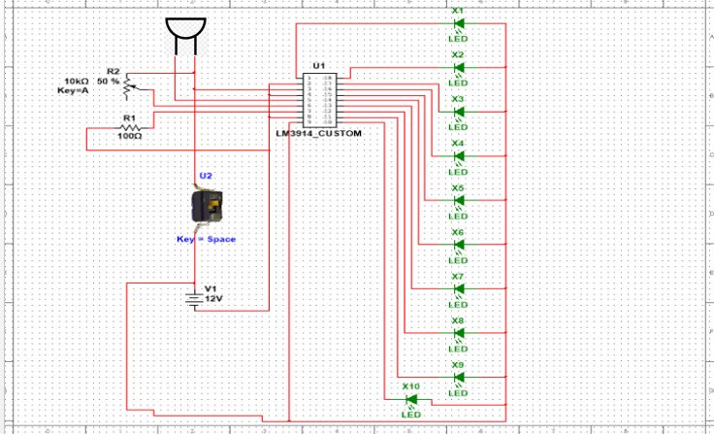

AUDIO LEVEL VISUALISER
SUBJECT:- ELECTRONIC WORKSHOP
CLASS:- ET1(E15)
GROUP MEMBER:-
GROUP MEMBER:-
PRUTHVIRAJ SANJAY KUMAR PATIL(202501070098)
PAWAN BALU GORAD(202501070093)
PRADYUN DHAMENDRA KAMBLE(202501070097)
SAAKET HARISH KULKARNI(202501070102)

Slide 2
INTRODUCTION
An audio visualizer is an electronic circuit that converts audio signal into visual indicators ie led allowing to check the variation of sound level.
In this project, an audio input is captured using microphone and the output is glow of led that glows according to strength of audio signals.
The main objective is to understand the basic principle of audio and signal processing.

Slide 3
Why this ?
We choose audio level visualizer because it helps us to understand practical applications of basic electronics concepts such as microphones, ICs, Led
This project give a brief information of audio signal processing where audio signals into electrical signals which gives visual output
This project allow allowed as to understand basics of PCB fabrication and learn essential skills like etching, drilling, soldering etc.

Slide 4
Objective
To design and implement an audio level visualizer circuit that converts audio signals into corresponding visual led indications based on sound intensity.
To understand the working audio input devices such as microphones and process of signal amplification and conditioning.
To gain practical knowledge of printed circuit board(PCB) fabrication including layout design, etching, drilling and soldering techniques

Slide 5
Block diagram
Sound source --- Microphone --- Pre-amplifier --- Lm3914 level detector --- led display (bar mode/ dot mode) --- Power supply {battery}
The block diagram represents the flow of signal from audio (microphone) to visual output (led).

Slide 6
Working principle
The circuit is powered using a 9V DC battery, which supplies power to the LM3914 IC, microphone, and LEDs. Proper grounding is provided to ensure noise-free operation of the circuit.
A microphone is used as the input device. It senses sound waves from the environment and converts them into a small electrical signal whose amplitude depends on the intensity of the sound.
Since the microphone output is very weak, a pre-amplification and signal conditioning stage is used. This stage consists of a 10k potentiometer and resistors, which help in amplifying the signal and adjusting the sensitivity of the circuit.
The amplified audio signal is fed to the input pin of the LM3914 IC. The potentiometer allows the user to control how many LEDs glow for a given sound level.

Slide 7
The LM3914 IC acts as a voltage level detector and LED driver. It internally compares the input voltage with 10 equally spaced reference voltage levels.
Depending on the magnitude of the input signal, the LM3914 activates the corresponding output pins, causing the connected LEDs to glow sequentially.
The LEDs are connected to the output pins of LM3914 in bar mode, where multiple LEDs glow simultaneously as the sound level increases.
A 100Ω resistor is used to limit the current flowing through the LEDs, thereby protecting them from damage.
As the sound intensity increases, the input voltage to LM3914 increases, resulting in more LEDs turning ON, providing a visual indication of audio level.
Thus, the circuit successfully converts audio signals into a visual LED display, making it useful for sound level monitoring and audio visualization.

Slide 8
components
Microphone
10K potentiometer
100 ohm resistor
9V battery
Lm3914
10 led
Connectors
Connecting wires
Cu plate(PCB)
switch

Slide 9
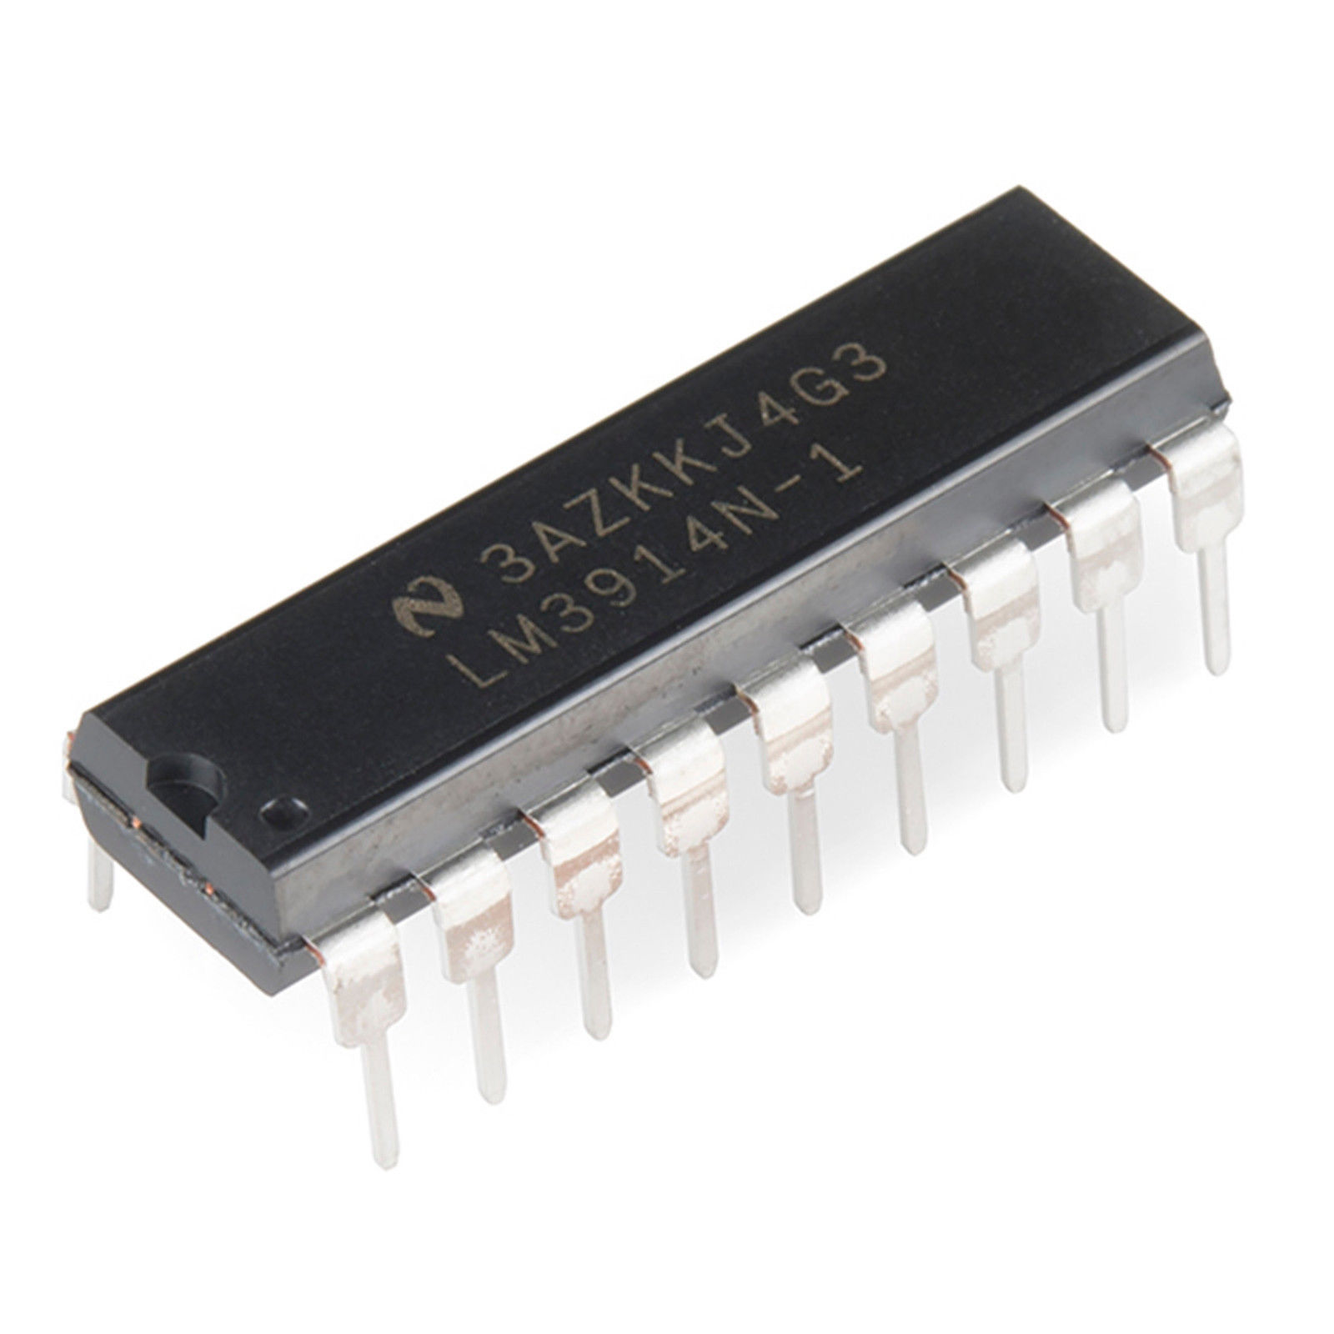
Role of lm3914 ic
Lm3914 detects the amplitude of the amplified audio signal and converts it into corresponding voltage levels representing sound intensity
It divides the input voltage into 10 discrete levels and activates leds sequentially based on the signal strength.

Slide 10
Role of 10k potentiometer
The 10k potentiometer is used to adjust the sensitivity of audio level visualizer.
It controls the reference voltage of the lm3914.
Used as pre- amplifier.

Slide 11
Role of 100 ohm resistor
The resistor is used to limit the flow of current through led to avoid damage
Improve the stability and reliability of the circuit.

Slide 12
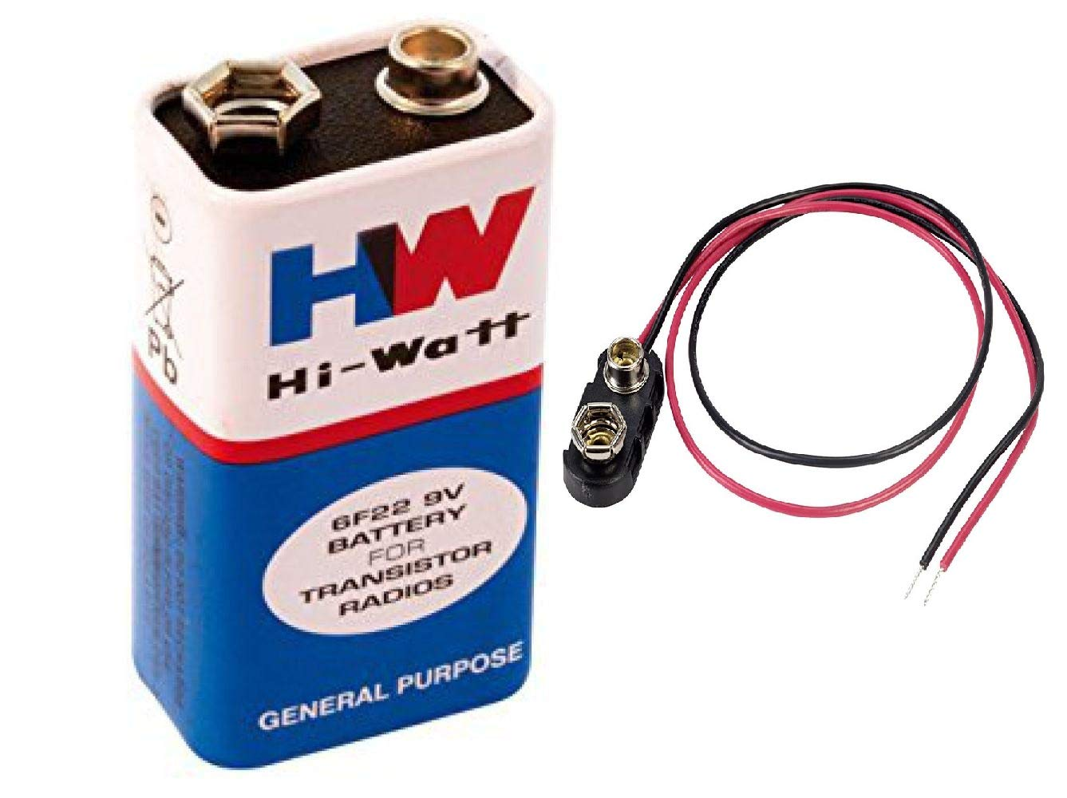
Role of 9v battery
Provide necessary voltage to operate the active components.
Enables the audio level visualizer to work without mains electricity

Slide 13
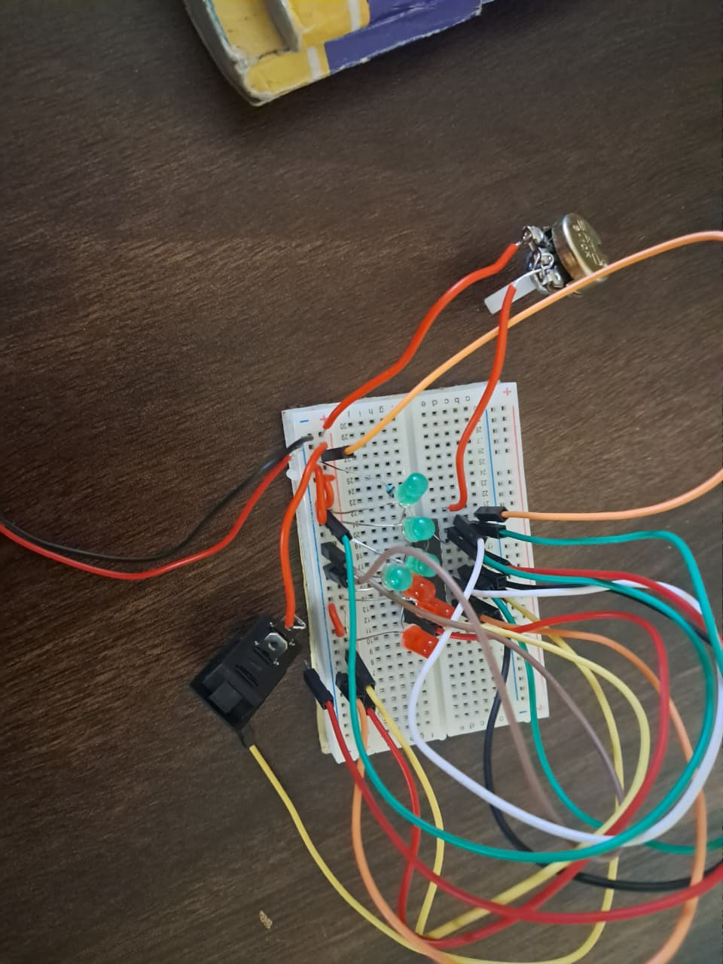
Breadboard testing
The circuit is first assembled on a breadboard
Working is verified before pcb fabrication.

Slide 14
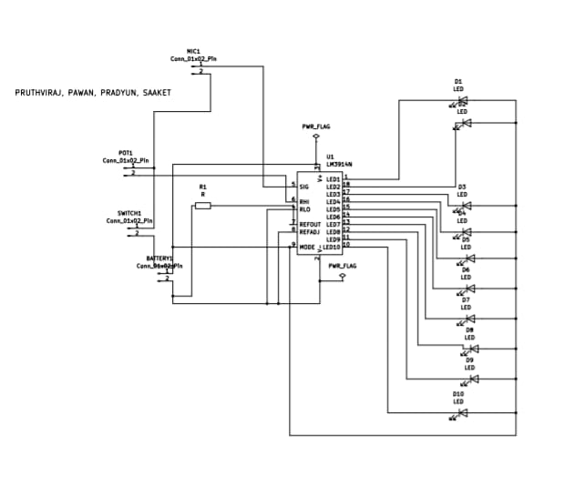
Pcb design
After successful testing, the circuit is converted into PCB layout.
Proper component placement is done.
Tracks are routed to avoid short circuit.

Slide 15
Pcb fabrication process
Copper board is cleaned properly.
PCB layout is transferred using ironing method.
Etching is done using ferric chloride solution.
Drilling is performed for component mounting
Final PCB is cleaned and inspected

Slide 16
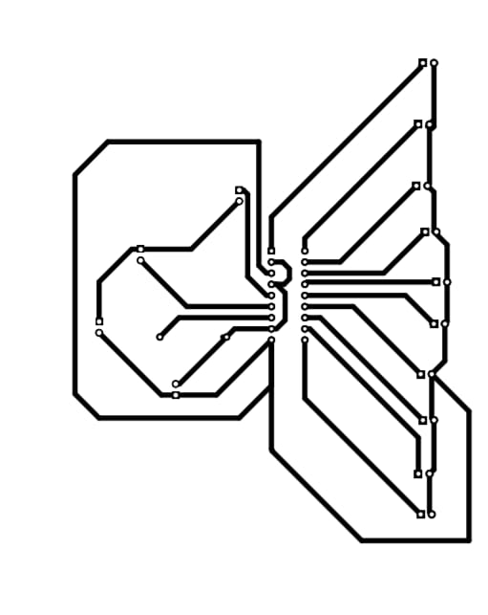
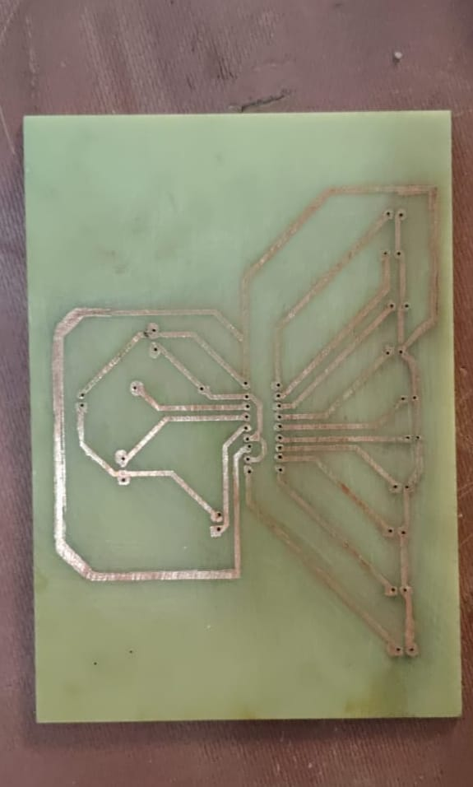
Process of pcb fabrication

Slide 17
Component mounting
All components are soldered carefully on PCB.
Solder joints are checked.
Continuity test is performed using multimetre.

Slide 18
Final hardware setup
The complete system is assembled.
The ic, potentiometer leds, switch, battery and mic are connected
The system is ready for real time operation

Slide 19
result
The leds are glowing according to the magnitude of input signal through the mic.

Slide 20
Advantages, applications and future scope
ADVANTAGES:-
Provides real time visual indication of audio strength.
Helps in preventing damage in speakers
APPLICATIONS:-
Used in music systems, DJ consoles and home theatres to display sound intensity.
Helps in audio testing and calibration.
FUTURE SCOPE:-
Use in smart vehicles, and smart devices.
Integration with iot, microcontrollers, and mobile apps for smart audio monitoring.

Slide 21


